Slide 1
ENERGY STAR® Most Efficient Consumer Electronics Sales Associate Training

Slide 2
What Is ENERGY STAR Most Efficient?
An extension of the trusted ENERGY STAR brand
Recognizes the most efficient products among those that qualify for the ENERGY STAR in a given year
Is intended to drive more energy efficient products into the market more quickly
Represents the “best of the best” in energy efficient products
See: www.energystar.gov/mostefficient

Slide 3
Why ENERGY STAR Most Efficient Matters To Your Customers
Product Differentiation –
Many use innovative and advanced technologies
Gives your customers leading edge products to chose from without trade off in features or functionality.
Social Value –
Helps your customers be environmentally responsible
Saving energy use helps prevent climate change by reducing greenhouse gas emissions
ENERGY STAR Integrity
The performance of all ENERGY STAR Most Efficient products is independently certified.

Slide 4
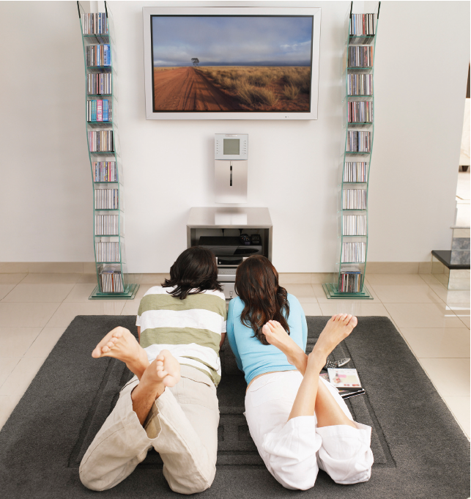
How To Leverage Most Efficient In Your Store
Energy & $$ Savings –
ENERGY STAR Most Efficient products save money!
Reduced energy use = lower energy bills
Increase sales (and ticket size) with exceptional product selection
Appeal to existing and new audiences
Early adopters and environmentally conscious shoppers
Build customer loyalty
Make customers feel good about their purchases
Make customers feel great about your stores stocking a top quality product!

Slide 5
Eligible Products
Boilers
Central Air Conditioners & Air-Source Heat Pumps
Geothermal Heat Pumps
Clothes Washers
Furnaces
Refrigerator-freezers
Televisions
Ceiling Fans
Computer Monitors
Residential Windows
Ventilating Fans

Slide 6
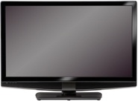
TV Eligibility
Models recognized as the Most Efficient of ENERGY STAR 2013 offer on average 50% energy savings compared a conventional product
Eligible products:
A TV designed primarily for the reception and display of audiovisual signals received from a set top box, or other digital or analog sources and consists of a tuner/receiver and a display encased in a single enclosure.
Ineligible products
None
Notes:
Proposed increase in performance criteria for 2013

Slide 7
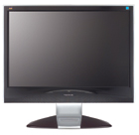
Computer Monitors Eligibility
Models recognized as the Most Efficient of ENERGY STAR 2013 offer on average 30% energy savings compared to a conventional product
Eligible products:
Monitors with a diagonal screen size greater than 12
inches and a pixel density greater than 5,000 pixels per square inch
Ineligible products
Digital picture frames
Professional displays
Notes:
Proposed increase in performance criteria for 2013

Slide 8
Product Listings
Find ENERGY STAR Most Efficient 2013 product listings, with photos and descriptions, at www.energystar.gov/mostefficient
and on manufacturer provided POP materials
The ENERGY STAR Most Efficient designation may not be factory applied to products or packaging but retailers are encouraged to use POP, in-store signage, and web sites to help customers identify recognized models.

Slide 9
Go Sell!
Two key talking points:
ENERGY STAR’s Most Efficient 2014 represent the leading edge products on the market.
ENERGY STAR’s Most Efficient 2014 TVs and displays are certified to save the most energy and money in their class.
Be sure to identify which models on the floor have been recognized for 2014:
See www.energystar.gov/mostefficient
See manufacturer and retail signage
The ENERGY STAR Most Efficient designation may not be factory applied to products or packaging but retailers are encouraged to use POP, in-store signage, and web sites to help customers identify recognized models.

Slide 10
Questions?
Visit www.energystar.gov/mostefficient
E-mail us at MostEfficient@energystar.gov

